Slide 1
Interim Project Pitch
By Thomas Simmons
K1906250

Slide 2






America Down Under
Intended game systems: AAA Consoles/ Games PC’s
Target age of players: 16+ (Tactical, Exploring & Competition)
PEGI/ ESRB rating: 16
Placeholder LOGO:

Slide 3
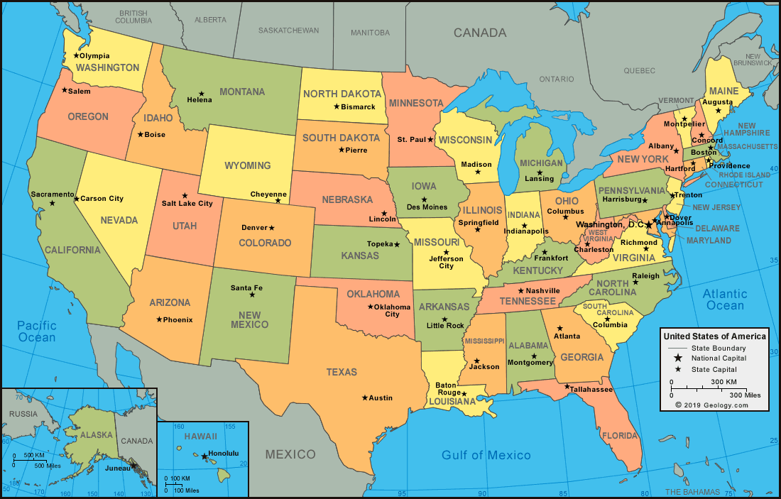


Game Outline/Story
Based in America in 2021
Third Person Shooter Role Playing Game
Trump vs rival politicians vs the people
The player is against the whole of America
The players choices effect their status
Secret serviceman guide
Fake Allies (In your character party)
Escape into Mexico

Slide 4
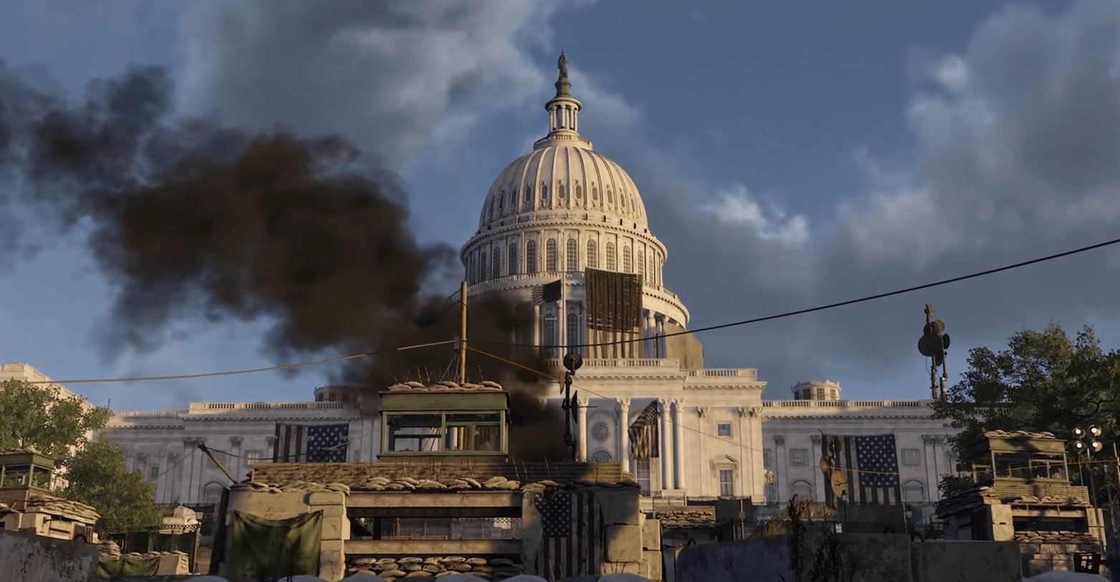
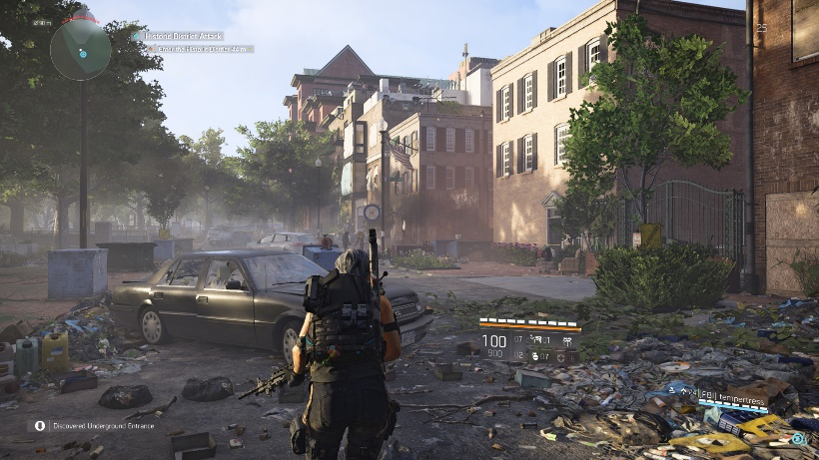
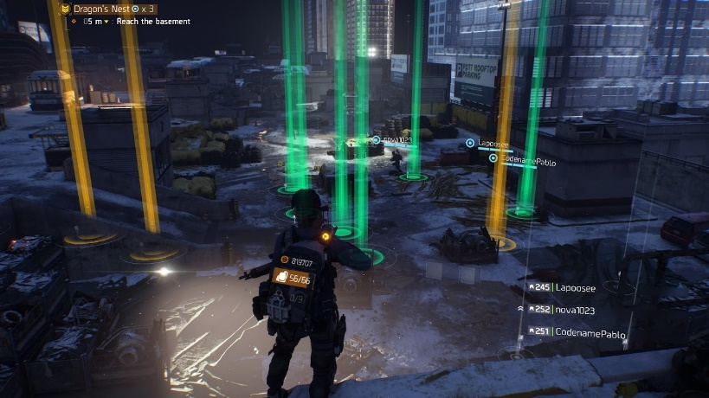
Context/Environment
Encounter Political characters/Rivals
Levels in/and cities have elements of destruction & vegetation
Challenge increases as player progresses
Rivals/ Enemies get stronger
Collect articles (Intel) objects in game
To progress through certain states/ cities they’ll be main enemies

Slide 5


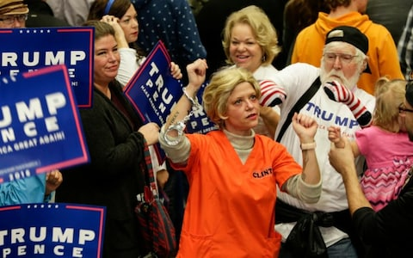
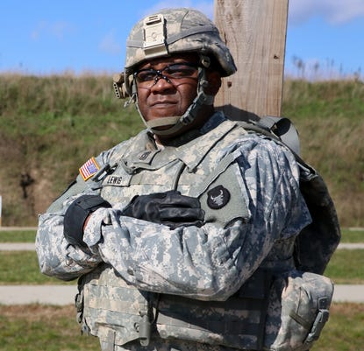
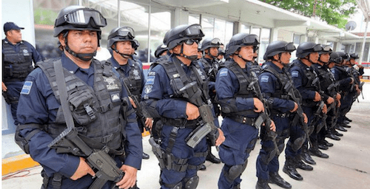
Characters
Players Character (Trump)
Allies (Trump enthusiasts/voters)
Enemies (Rival Politicians, American People)
Heroes (Party Members, Secret Service)
National Guard & Police
Mexican Police & People

Slide 6
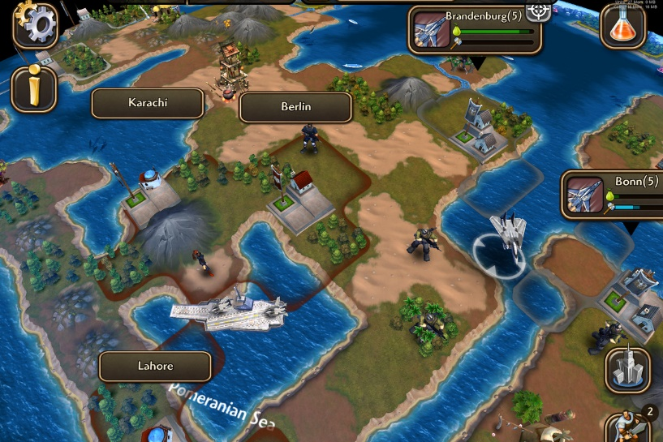
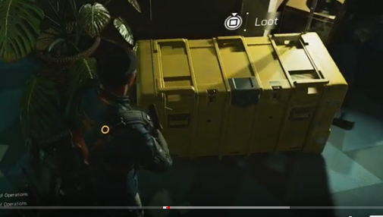
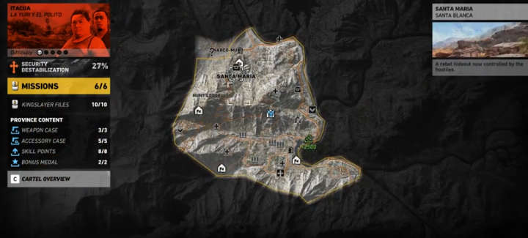
Gameplay
Moving across the map to try and escape America
Gather influence/ collectables to earn in game currency
Player character dies, respawn at last save
In the levels the player is introduced to new abilities
Empathise with rivals/enemies

Slide 7
Game Balancing
The easier the level the more common the rewards are
Players can earn bonuses during the level
Big risk = big rewards
After a number of attempts player is recommended help
Both turtling and rushing strategies apply

Slide 8
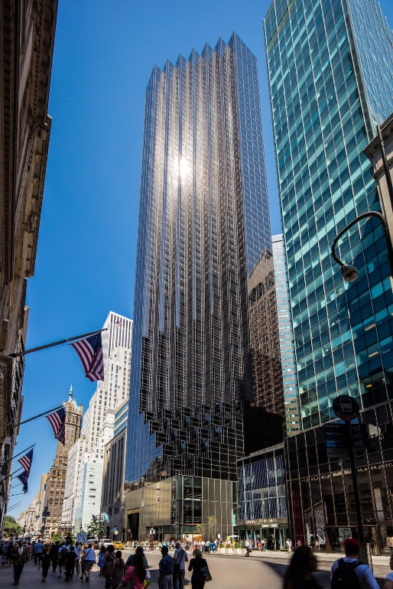
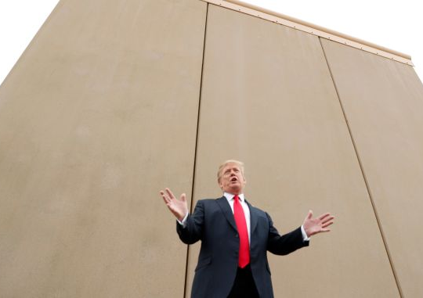


World/Locations
Iconic Buildings/ structures (Mexican wall) represented
Cities and states provide difficulty level and rewards
Map of America
Audio included in different scenarios
Find intel of real world articles/ news stories

Slide 9
Game Experience
Players will feel sadness towards America and the state its in
Destruction, no hope, frustration
Signs of overgrown vegetation
Fun/ laugh towards characters being used

Slide 10
Game Mechanics
Players interact with objects
Can find and pick up weapons/ armour
Encounter traps/ hazards human/ naturally made
An assistance menu/ menu

Slide 11
In Game Purchases
Purchases of different armours/ bullet proof vests
Outfits for characters
Purchased allies such as mercenaries/ secret servicemen
Loyalists/ Trump enthusiasts

Slide 12
Questions?

